Slide 1


User Registration Guide

Slide 2

Set Up Account Details

Slide 3


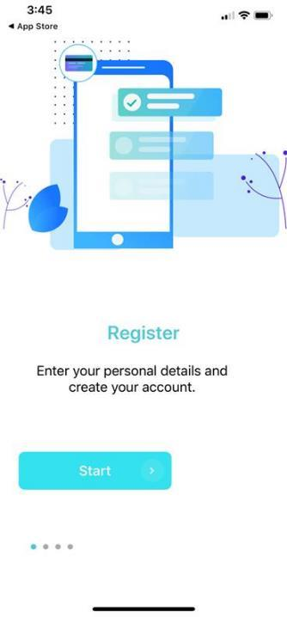
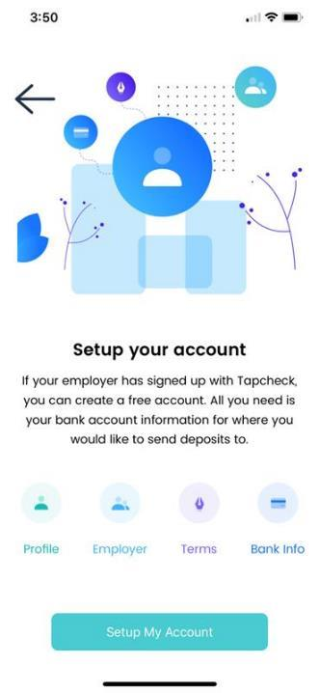
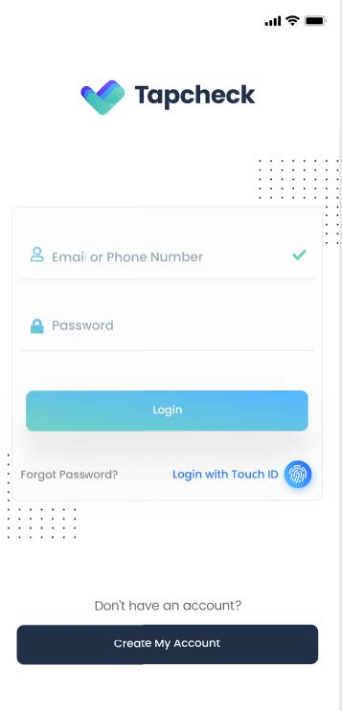
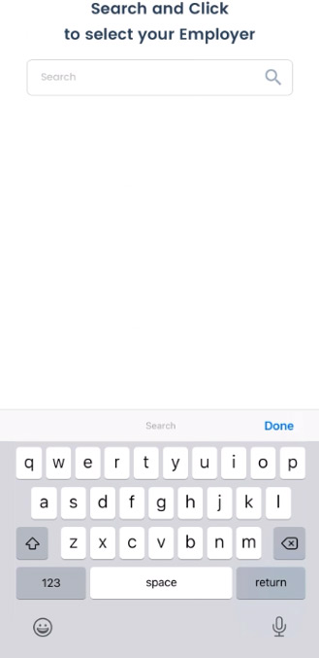

User Tab
Search Employer
Tap “Start” to begin
Use tab ”create my account” to start registration
Users search and find their employer
Set up your
account.

Slide 4
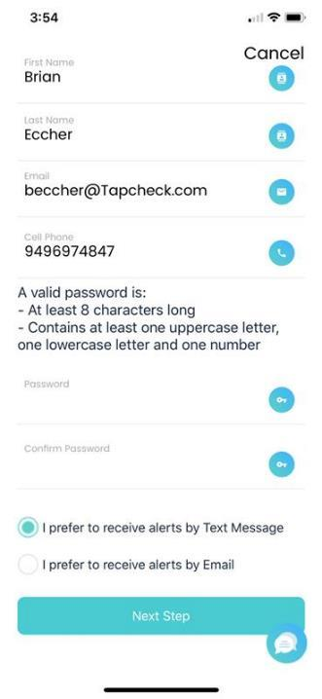
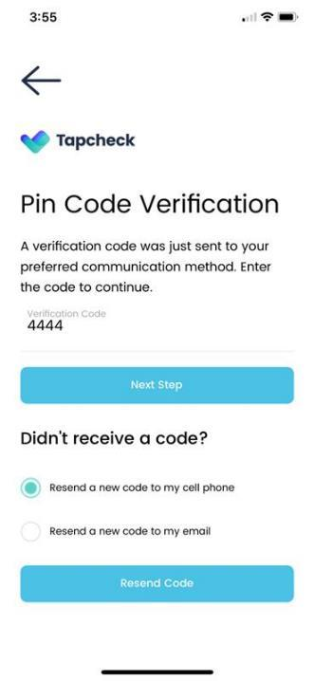
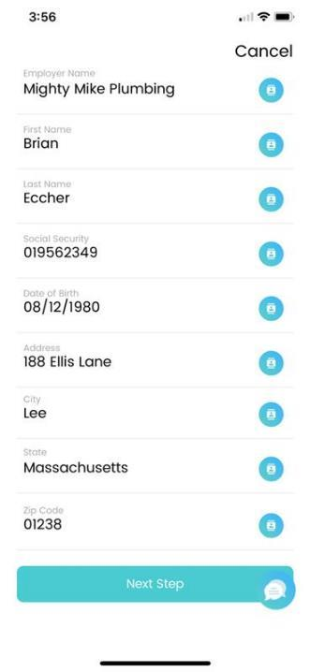
Create Profile
Enter Pin Code
Payroll Profile
Create your account and password.
Enter security code and preferred communication method.
Start typing your employer’s name and select it from the list.
(Your name, social security and date of birth must match your payroll record)

Slide 5
User Agreement
& Set Up Transfer Options

Slide 6
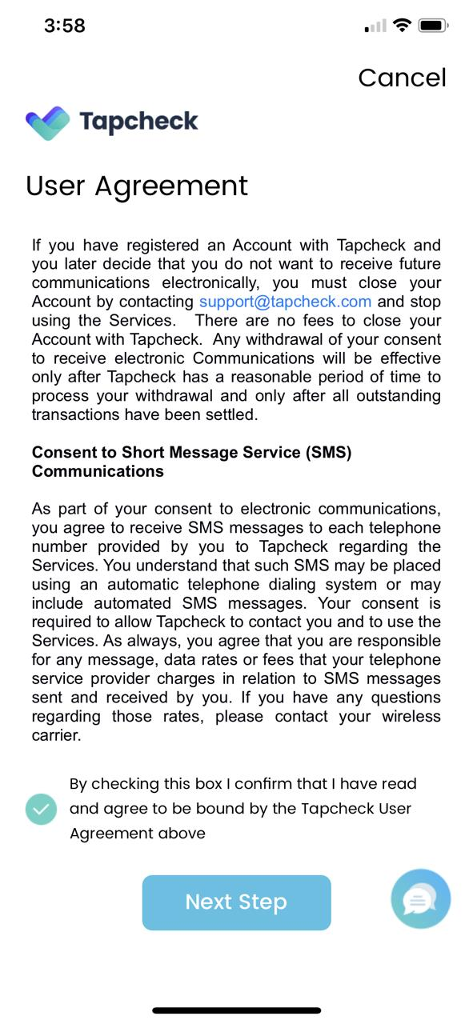
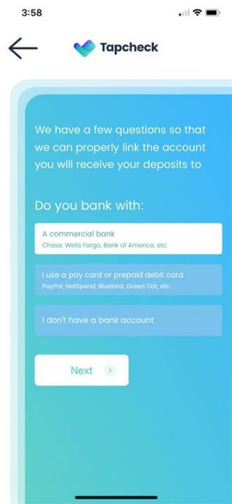
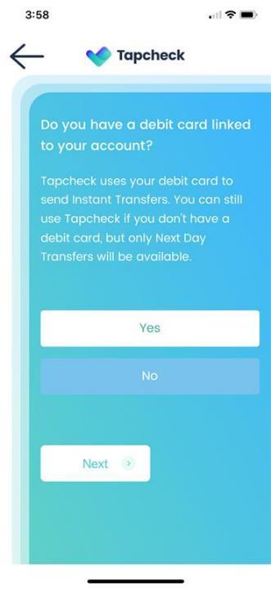
User Agreement
Select Transfer Option
Debit Card Option
Read through and agree to the Terms & Conditions.
If you have an existing bank, select option 1. If not, select to receive a free Tapcheck Paycard.
Verify having a debit card linked to your bank account.
If yes, you can receive Instant transfers. If not, you can still sign up for Next Day transfers.

Slide 7
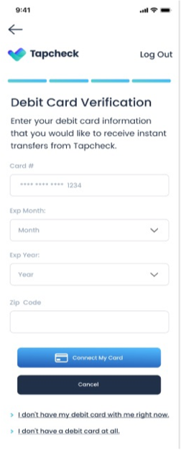
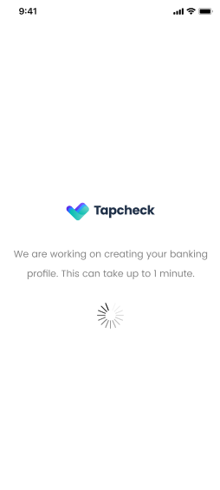
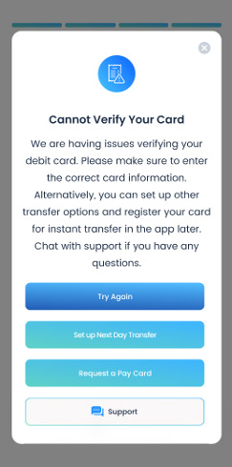
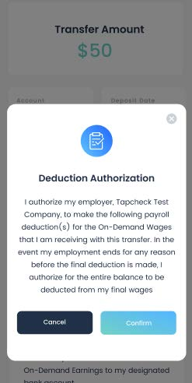
Card Verification Error
!
Enter your debit card number.
If your bank does not offer instant transfers, you will receive an error on this screen. Click Cancel to sign up for Next Day or receive a free paycard.
Setting up the debit card for instant transfer
Your Options:
Try Again
Set up next day transfer
Request a paycard
Talk to customer support

Slide 8
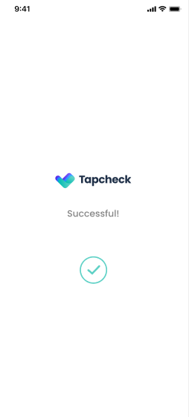
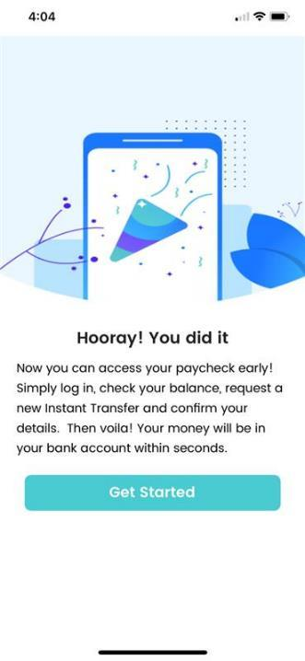

Debit card setup successful
Your account registration is complete!
Login using the email and password you just created.

Slide 9
Make Transfers

Slide 10
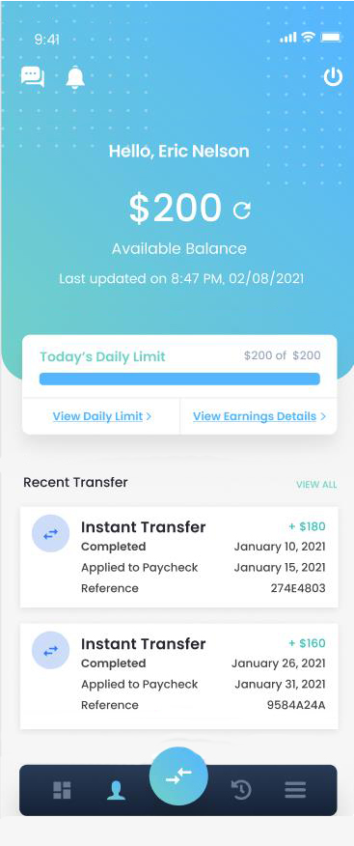
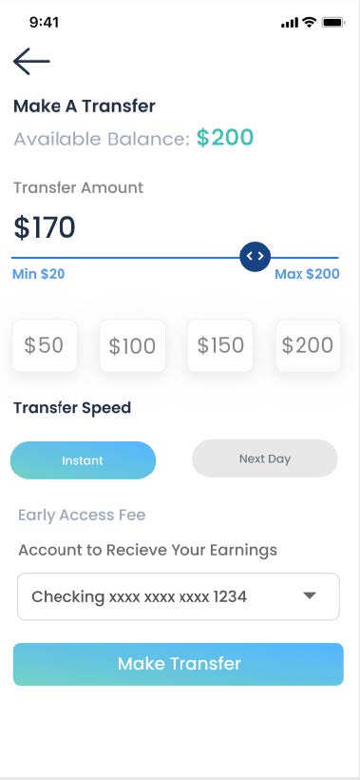
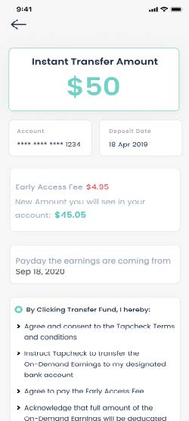
Tap the circle transfer button at the bottom of the screen.
Select the amount, speed, and account to receive your deposit.
Verify the transfer details and agree to the terms.

Slide 11
Instant Access
Transfers are usually funded within seconds and can be completed 24/7, 365.
Next Day
Cut off time is 3:00 PM PST to receive funds the following business day. Excludes holidays and weekends.
Read through and agree to the Terms & Conditions.
Transfer fees are $3.95 for next day transfers and $4.95 for instant transfers.

Slide 12
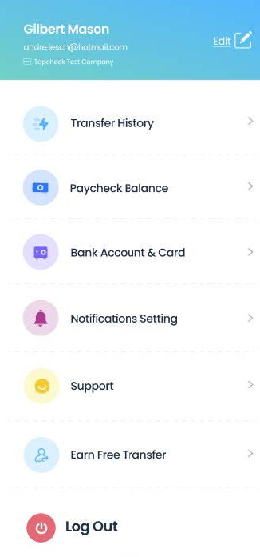
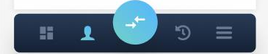
You can track your transfers and payroll deductions in your Transfer History.
My Paycheck Balance shows any paycheck that has a Tapcheck Deduction.
Use Bank Account & Card to add a new bank account/card or change an existing account.
Notifications Setting will set up push, SMS and email notifications regarding the account activities.
Contact Support by Chat or submit a ticket for any questions.
Employees can refer Tapcheck to their coworkers and get a transfer for free once the receiver registers with Tapcheck.

Slide 13

Thank
you!
866-697-6016
support@tapcheck.com
18757 Burbank Blvd. Ste. 109
Tarzana, CA 91356
Contact Us to Get Started
www.tapcheck.com

Slide 14


Thank you!
Follow us!
Follow us for fun and inspiring updates about financial wellness, budgeting, saving and more!

